Slide 1
Survivable Hybrid Wireless Optical Broadband Access Network
Ferhan Jamal
100953487 (Carleton University)

Slide 2
Introduction
WOBAN is arising as a promising architecture for the coming generation access networks
Main aim of WOBAN is to provide economical and scalable broadband internet access
It is cross-domain network architecture
End users receive internet access through wireless mesh network (front-end)
WMN (Wireless Mesh Network) is connected with optical backhaul via gateway nodes
Notes:
Why it is cross domain network architecture ?
Because there are 2 domains operating seperately

Slide 3
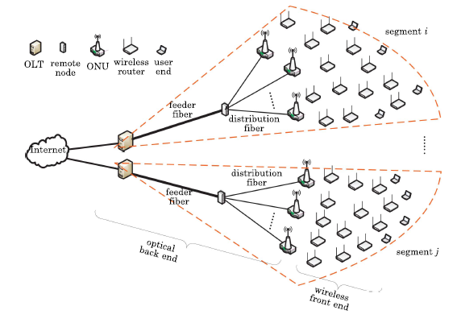
WOBAN Architecture

Slide 4
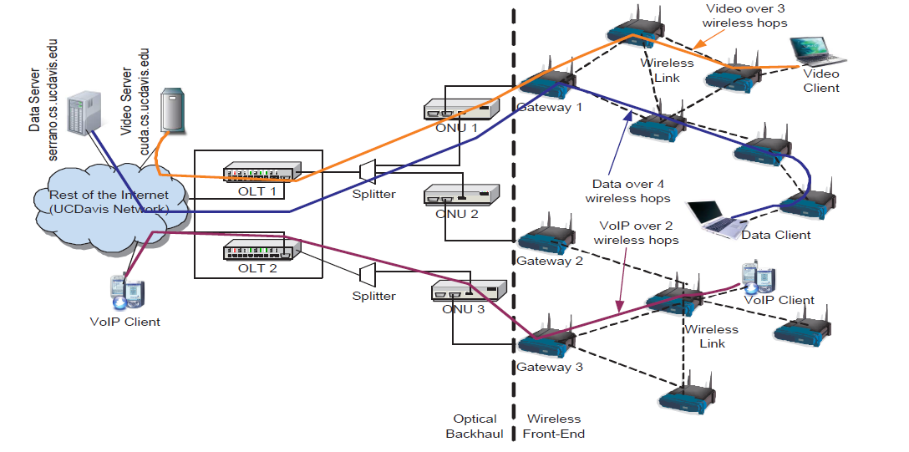
WOBAN Architecture (Continued…)
Notes:
Gateway is the point where optical part meets the wireless part
Optical network unit : It is the point which terminates the optical network which can be connected to various users
Optical Line Terminal : An optical line terminal (OLT) is the endpoint hardware device in a passive optical network (PON). It controls all the things

Slide 5
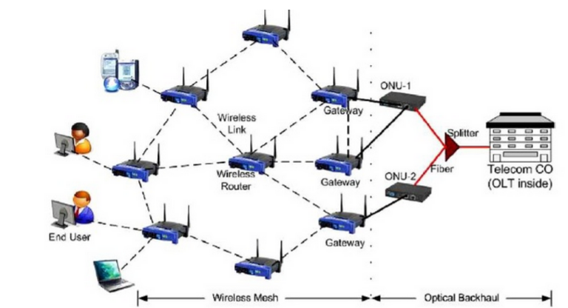
WOBAN Architecture (Continued…)

Slide 6
Features
Fault tolerance
WOBAN self-organize themselves if any OLT fails or breaks
Failures can be ONU failure, fiber break down, router failure, etc.
Optimal Routing takes place in the network when any of these failures occur
Low management and deployment cost
Low power consumption of the wireless nodes
Every nodes features programmability

Slide 7
Features (Continued…)
Robustness
Failures in optical networks are less
It carries a lot of data so bottleneck and congestion are lesser than other media
Interference is greatly reduced as “light media” is not easily susceptible to interference
Security is very high
Notes:
Bottleneck: The point where data slows down because of some issue
Interference:

Slide 8
Survivability of optical end
There are two types of survivability :
Protection
Path Protection
Link Protection
Restoration
Link Restoration
Path Restoration
Sub-Path Restoration

Slide 9
Survivability in wireless end
Establish primary (working) and secondary (backup) paths
Risk Groups are avoided
Frequency assignment for upstream/downstream as well as working/backup

Slide 10
Conclusion
High Bandwidth
Bandwidth received in this technology is very high
Solved the problem for future Last-Mile Access Networks
Flexibility
Cost-effectiveness

Slide 11
References
S. H Mohammada, N. Zulkiflia and S. M. Idrus, “A Review of Integrated Optical and Wireless Broadband Access Networks”, Jurnal Teknologi
Lei Guo, Yejun Liu, Fanzhao Wang, Weigang Hou, and Bo Gong, “Cluster-Based Protection for Survivable Fiber-Wireless Access Networks”, J. OPT. COMMUN. NETW./VOL. 5, NO. 11/NOVEMBER 2013
Pulak Chowdhury, Suman Sarkar, Glen Kramer, Sudhir Dixit, and Biswanath Mukherjee, “Hybrid Wireless-Optical Broadband Access Network (WOBAN): Prototype Development and Research Challenges”
N. Correia, J. Coimbra, and G. Schütz, “Fault-Tolerance Planning in Multiradio Hybrid Wireless–Optical Broadband Access Networks”, VOL. 1, NO. 7/DECEMBER 2009/ J. OPT. COMMUN. NETW.
Neeraj Mohan, Amit Wason and Parvinder S. Sandhu, “Trends in Survivability Techniques of Optical Networks”, International Journal of Computer Science and Electronics Engineering (IJCSEE) Volume 1, Issue 2 (2013) ISSN 2320–401X (Print)
Himanshi Saini and Amit Kumar Garg, ”Protection and Restoration Schemes in Optical Networks: A Comprehensive Survey”, Volume 2, No.1, January – February 2013 International Journal of Microwaves Applications

Slide 12

Questions?

